Slide 1
ASCEP with Scipion3
鍾思齊
Courtesy of 蕭卉倫/林新閎

Slide 2
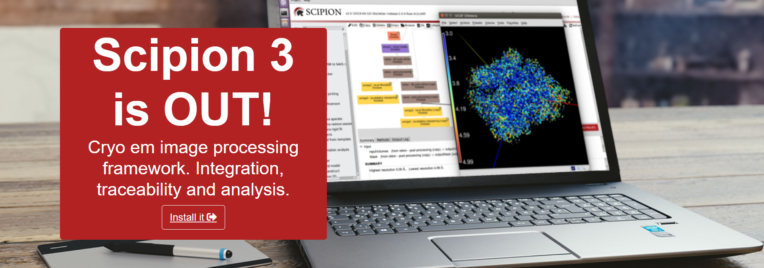
Outline
Usage of Sever
Data source
ASCEP with Scipion3
Workflow and IO
Basic Usage

Slide 3
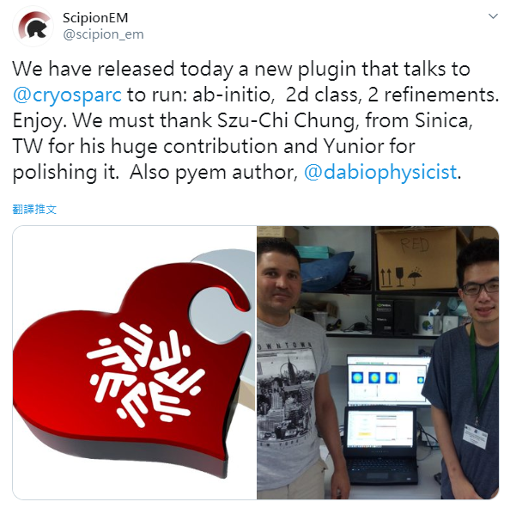
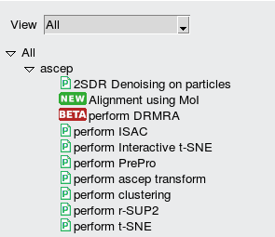
ASCEP – Unified cryo-EM processing platform
Statistical tools build by our team
State-of-the-art packages
Dowload at: http://sabid.stat.sinica.edu.tw/
Notes:
Additional packages:
Prime 3
EMAN2 for conversion
Xmipp3 for scipion
RELION, CisTEM
CryoSparc, SPHIRE(ISAC)

Slide 4
Developing scipion3
Developer’s doc
https://scipion-em.github.io/docs/docs/developer/tutorials/dev-tutorials
https://scipion-em.github.io/docs/docs/developer/developers.html#extending-scipion
https://scipion-em.github.io/docs/docs/developer/symmetries
Methods
https://github.com/scipion-em
https://github.com/phonchi/Computational-CryoEM

Slide 5
Usage of Server

Slide 6
Use our Server
Create account if you do not have one
Server IP: 140.109.74.85 (80 cores, 2GPU), 140.109.74.82 (88 Cores, 8 GPU)
Related programs
FileZilla: https://filezilla-project.org/ → Download/upload files
Remote desktop
MobaXterm: https://mobaxterm.mobatek.net/download.html → Command line, built-in X server
Vnc-viewer : https://www.realvnc.com/en/connect/download/viewer/ → Connect to specific session
Putty +Xming : https://www.putty.org/ , https://sourceforge.net/projects/xming/
Chimera: https://www.cgl.ucsf.edu/chimera/download.html

Slide 7
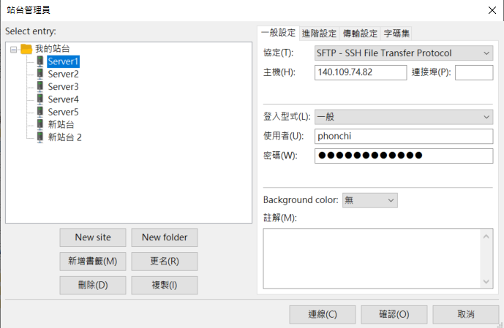
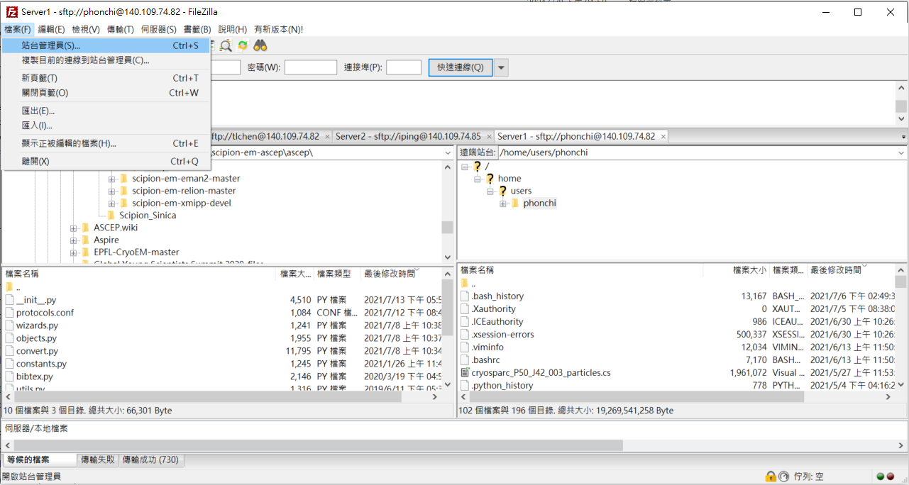
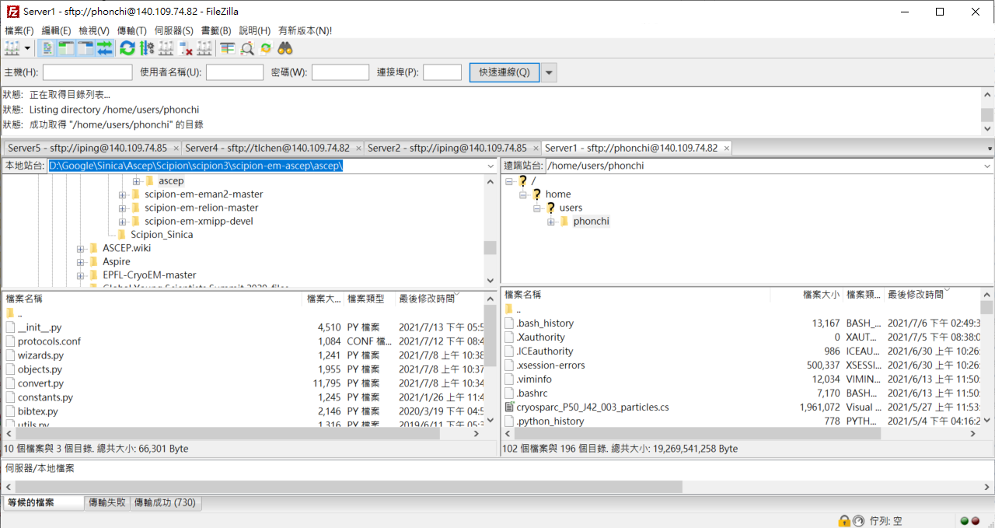
FileZilla
檔案→站台管理員→連線
(第一次使用先按增新站台→輸入資料→確認)
.
在需要的下載或上傳檔案，
按下滑鼠右鍵會出現功能選項

Slide 8
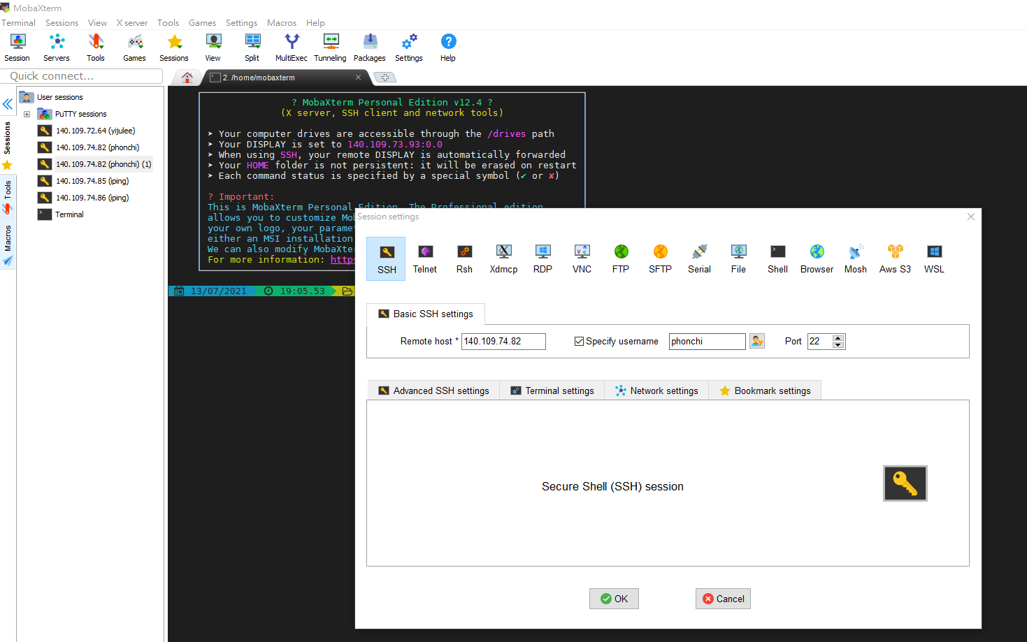
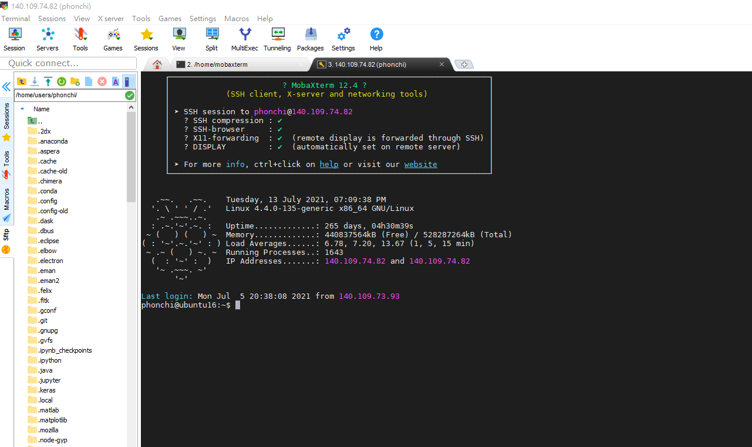
MobaXterm
第一次使用
先按session→ SSH →輸入IP → OK
在ssh 輸入echo xfce4-session > ~/.xsession

Slide 9
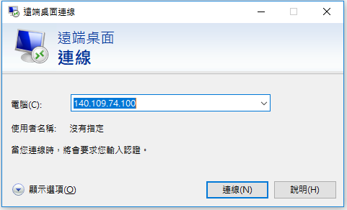
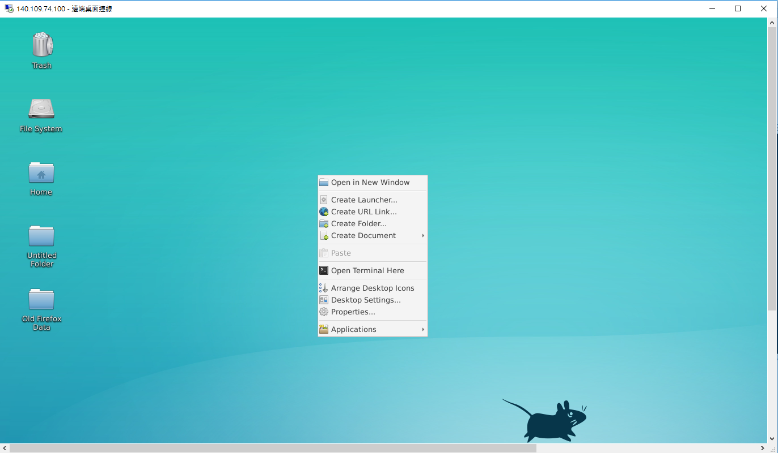
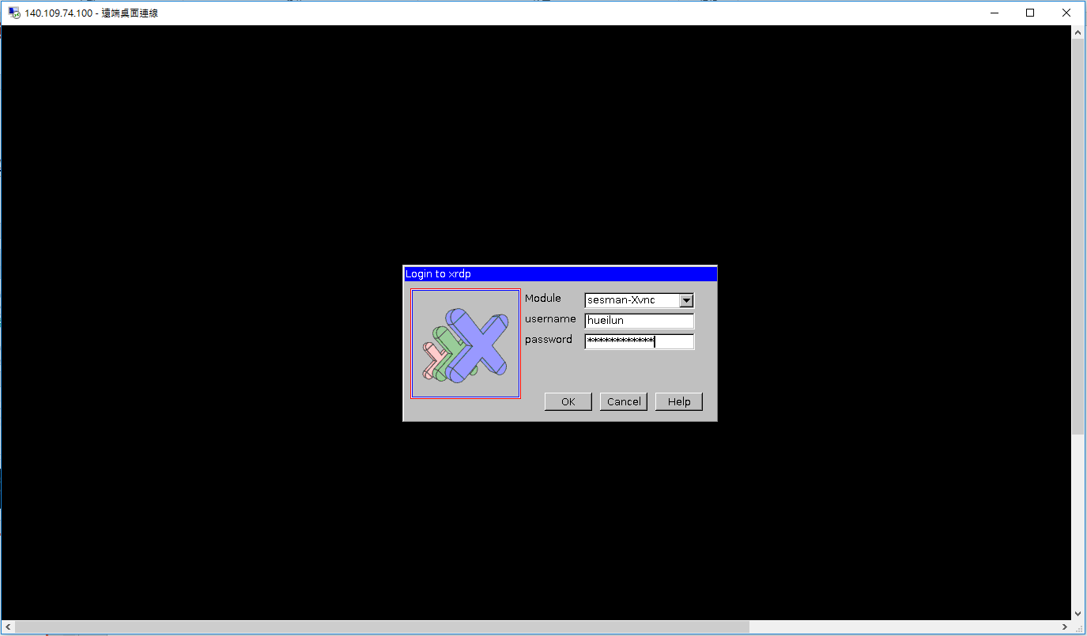
Remote Desktop
這個工作列按滑鼠右鍵會出現，再點 Open Terminal Here，
就可以操作我們要用的指令
如果在terminal，無法開啟scipion，可以嘗試
輸入 source ~./bashrc

Slide 10
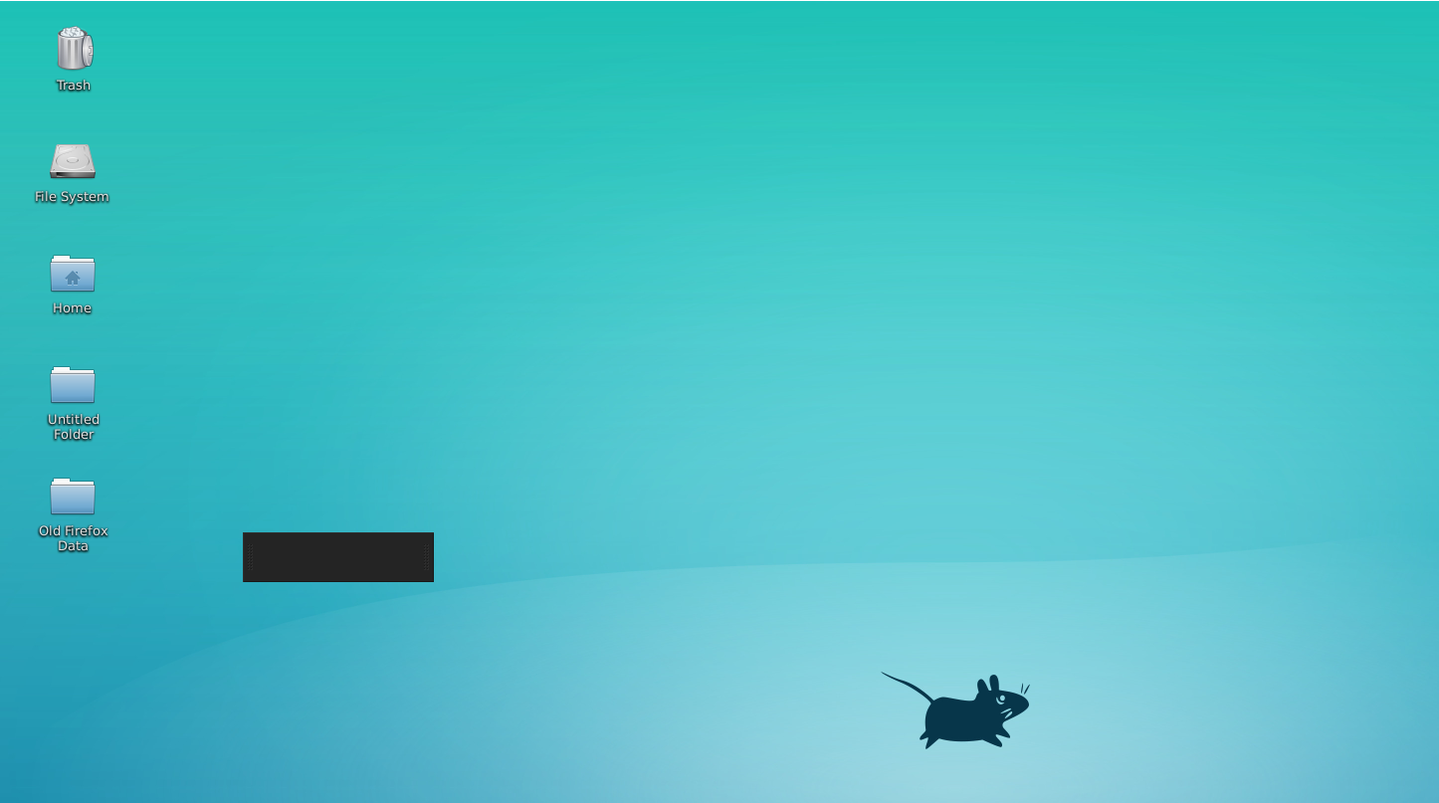
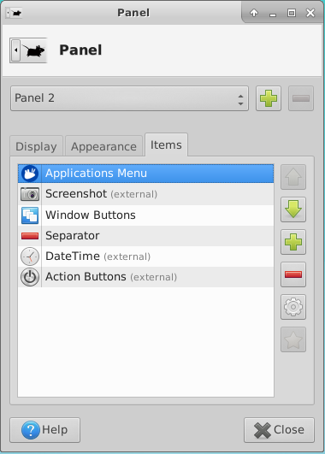
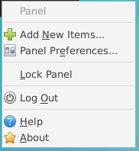
Trouble shooting
在這個黑色框框，按右鍵會有選項
加入這兩項
此動作只是為了建造工作列，方便使用
下方Panel Preference 可調整工具列方向

Slide 11
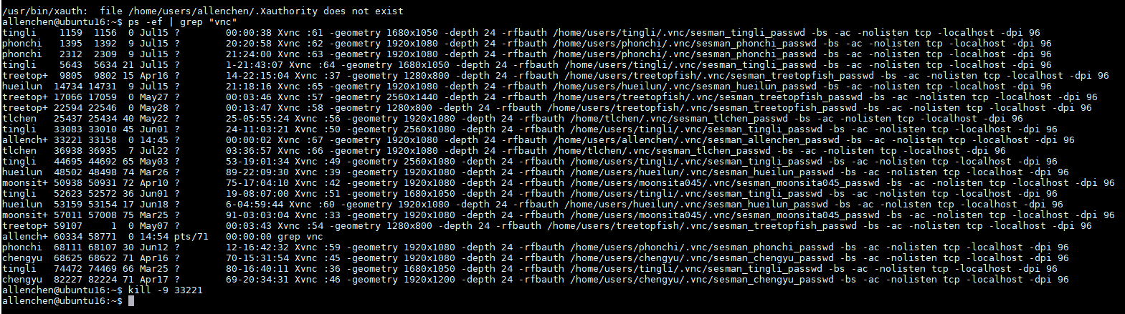
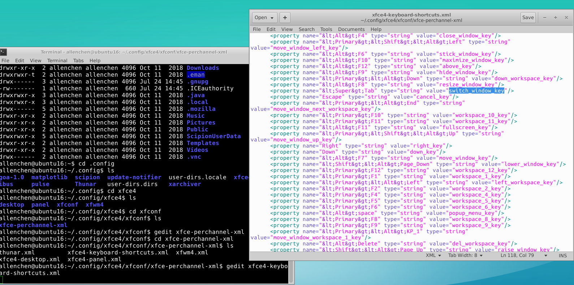
Trouble shooting
Enable the Tab
After modification, You may need to kill the old session to enable it
Change it to empty

Slide 12
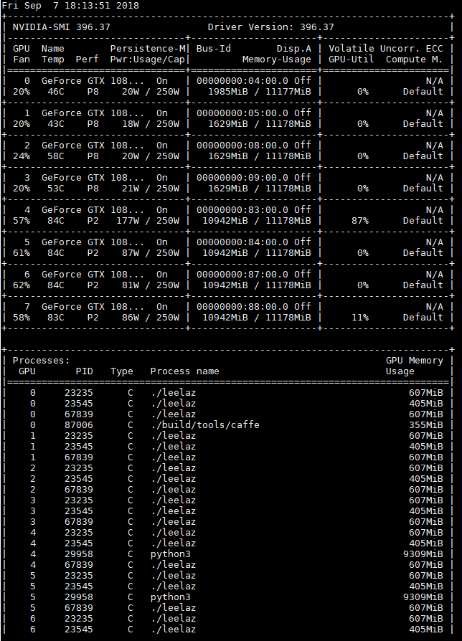
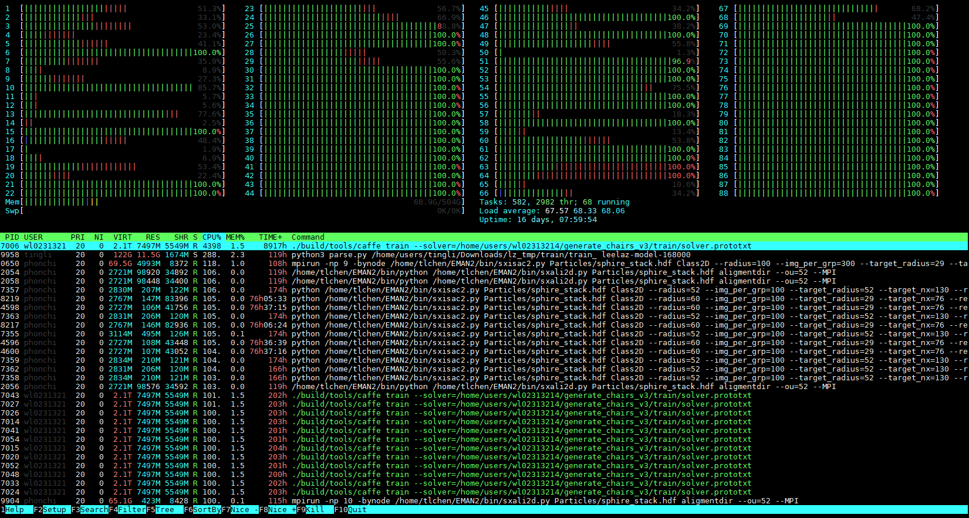
Useful commands
htop → 查看CPU 使用量
nvidia-smi →查看GPU 使用量
https://www.guru99.com/linux-commands-cheat-sheet.html

Slide 13
Data Source

Slide 14
Data Source
Tutorial data:
/nas2/CryoEM_data
EMPIAR
/nas2/
ASCEM
/nas2/cryoEM_data
Additional
/nfs/

Slide 15
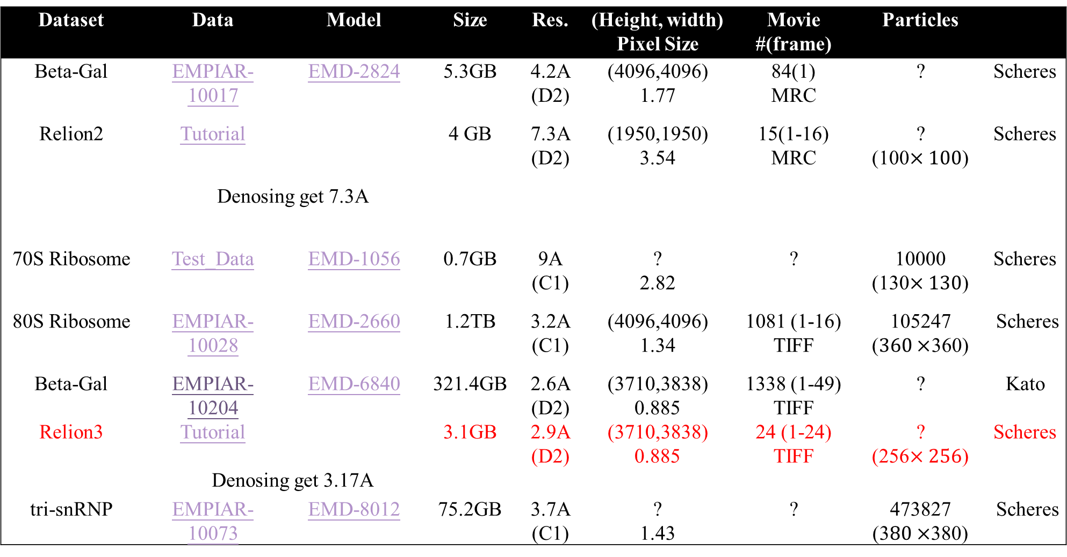
Dataset | Data | Model | Size | Res. | (Height, width) Pixel Size | Movie #(frame) | Particles
Beta-Gal | EMPIAR-10017 | EMD-2824 | 5.3GB | 4.2A (D2) | (4096,4096) 1.77 | 84(1) MRC | ? | Scheres
Relion2 | Tutorial |  | 4 GB | 7.3A (D2) | (1950,1950) 3.54 | 15(1-16) MRC | ? (100$×100$) | Scheres
Denosing get 7.3A
70S Ribosome | Test_Data | EMD-1056 | 0.7GB | 9A (C1) | ? 2.82 | ? | 10000 (130$×130$) | Scheres
80S Ribosome | EMPIAR-10028 | EMD-2660 | 1.2TB | 3.2A (C1) | (4096,4096) 1.34 | 1081 (1-16) TIFF | 105247 ($360×$360) | Scheres
Beta-Gal | EMPIAR-10204 | EMD-6840 | 321.4GB | 2.6A (D2) | (3710,3838) 0.885 | 1338 (1-49) TIFF | ? | Kato
Relion3 | Tutorial |  | 3.1GB | 2.9A (D2) | (3710,3838) 0.885 | 24 (1-24) TIFF | ? (256$×256$) | Scheres
Denosing get 3.17A
tri-snRNP | EMPIAR-10073 | EMD-8012 | 75.2GB | 3.7A (C1) | ? 1.43 | ? | 473827 (3$80×$380) | Scheres

Slide 16
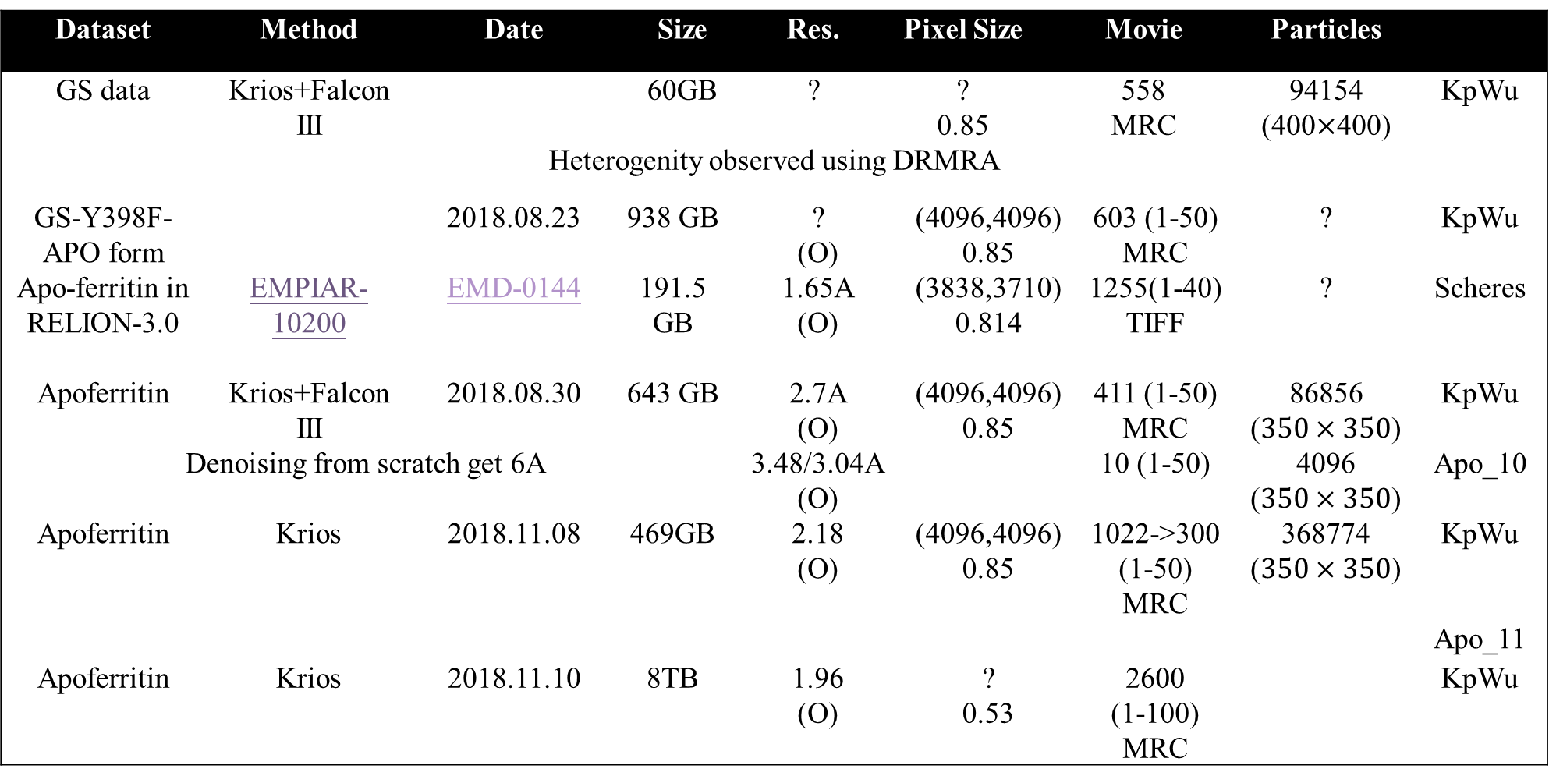
Dataset | Method | Date | Size |  | Res. | Pixel Size |  | Movie |  | Particles
GS data | Krios+Falcon III |  | 60GB |  | ? | ? 0.85 |  | 558 MRC |  | 94154 (400$×$400) | KpWu
Heterogenity observed using DRMRA
GS-Y398F-APO form |  | 2018.08.23 | 938 GB | ? (O) |  |  | (4096,4096) 0.85 |  | 603 (1-50) MRC | ? | KpWu
Apo-ferritin in RELION-3.0 | EMPIAR-10200 | EMD-0144 | 191.5 GB | 1.65A (O) |  |  | (3838,3710) 0.814 |  | 1255(1-40) TIFF | ? | Scheres
Apoferritin | Krios+Falcon III | 2018.08.30 | 643 GB | 2.7A (O) |  |  | (4096,4096) 0.85 |  | 411 (1-50) MRC | 86856 ($350×350$) | KpWu
Denoising from scratch get 6A |  |  |  | 3.48/3.04A (O) |  |  |  |  | 10 (1-50) | 4096 ($350×350$) | Apo_10
Apoferritin | Krios | 2018.11.08 | 469GB | 2.18 (O) |  |  | (4096,4096) 0.85 |  | 1022->300 (1-50) MRC | 368774 ($350×350$) | KpWu
 |  |  |  |  |  |  |  |  |  |  | Apo_11
Apoferritin | Krios | 2018.11.10 | 8TB | 1.96 (O) |  |  | ? 0.53 |  | 2600 (1-100) MRC |  | KpWu

Slide 17
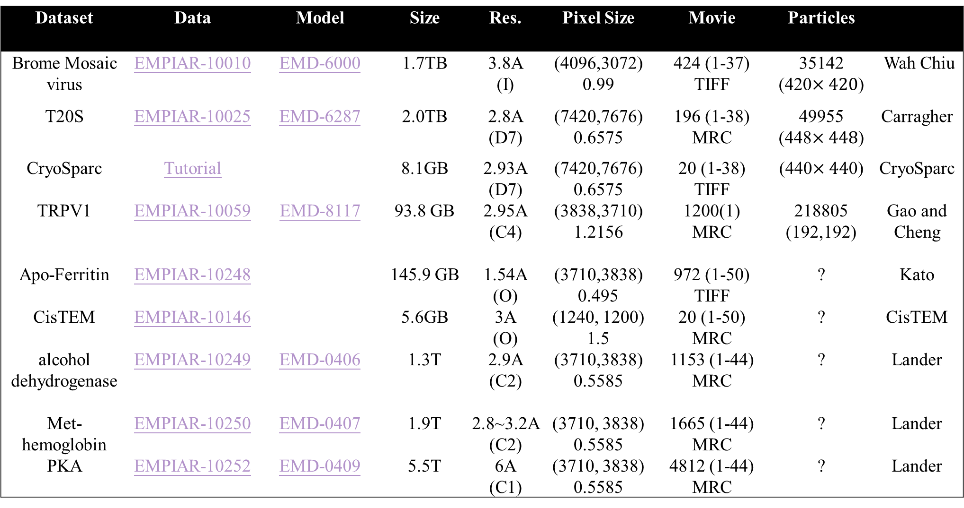
Dataset | Data | Model | Size | Res. | Pixel Size | Movie | Particles
Brome Mosaic virus | EMPIAR-10010 | EMD-6000 | 1.7TB | 3.8A (I) | (4096,3072) 0.99 | 424 (1-37) TIFF | 35142 (420$×420$) | Wah Chiu
T20S | EMPIAR-10025 | EMD-6287 | 2.0TB | 2.8A (D7) | (7420,7676) 0.6575 | 196 (1-38) MRC | 49955 (448$×448$) | Carragher
CryoSparc | Tutorial |  | 8.1GB | 2.93A (D7) | (7420,7676) 0.6575 | 20 (1-38) TIFF | (440$×44$0) | CryoSparc
TRPV1 | EMPIAR-10059 | EMD-8117 | 93.8 GB | 2.95A (C4) | (3838,3710) 1.2156 | 1200(1) MRC | 218805 (192,192) | Gao and Cheng
Apo-Ferritin | EMPIAR-10248 |  | 145.9 GB | 1.54A (O) | (3710,3838) 0.495 | 972 (1-50) TIFF | ? | Kato
CisTEM | EMPIAR-10146 |  | 5.6GB | 3A (O) | (1240, 1200) 1.5 | 20 (1-50) MRC | ? | CisTEM
alcohol dehydrogenase | EMPIAR-10249 | EMD-0406 | 1.3T | 2.9A (C2) | (3710,3838) 0.5585 | 1153 (1-44) MRC | ? | Lander
Met-hemoglobin | EMPIAR-10250 | EMD-0407 | 1.9T | 2.8~3.2A (C2) | (3710, 3838) 0.5585 | 1665 (1-44) MRC | ? | Lander
PKA | EMPIAR-10252 | EMD-0409 | 5.5T | 6A (C1) | (3710, 3838) 0.5585 | 4812 (1-44) MRC | ? | Lander

Slide 18
ASCEP with Scipion3

Slide 19
Install ASCEP
Install scipion3 http://scipion.i2pc.es/
Install scipion-em-relion, scipion-em-eman2, scipion-em-xmipp, scipion-em-cryosparc2, scipion-em-chimera
scipion3 conf
gedit scipion/config.py
ASCEP_DIR=/path/to/ascep
EMAN231DIR=/path/to/ascep
Modify the cuda path in scipion-em-ascep/ascep/__init__.py (cupy-cudaxx)
scipion3 install –p /path/to/scipion-em-ascep/--devel

Slide 20
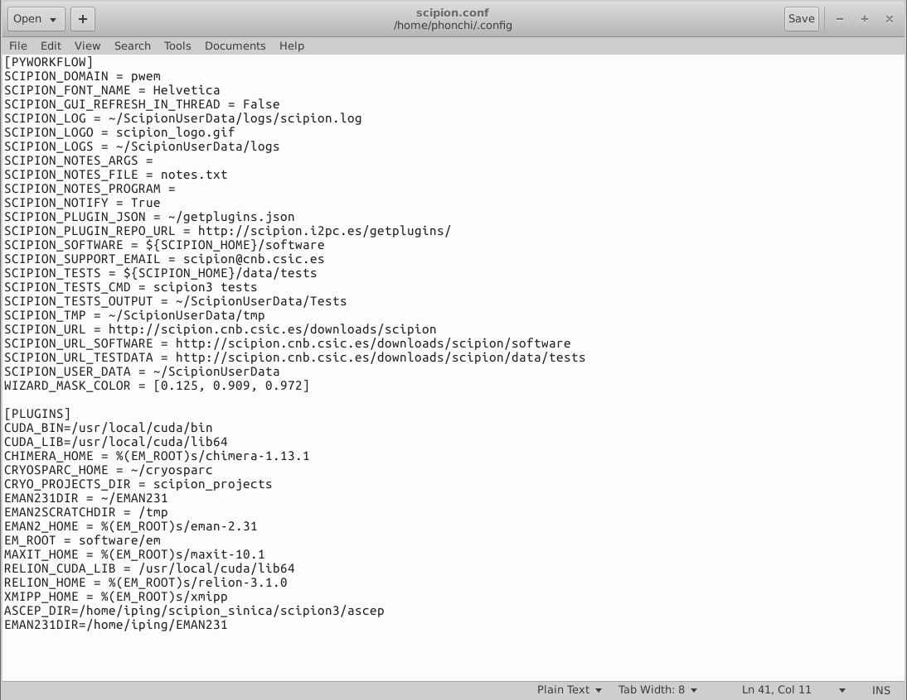
Enable Scipion3
gedit ~/.bashrc
Add export PATH=/home/iping/scipion3/:$PATH to the end the file
source ~/.bashrc
scipion3 config
Press any key other than Enter

Slide 21
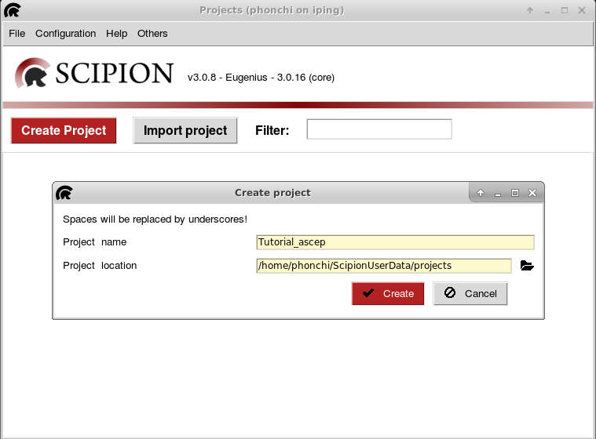
Import Project
直接在指令視窗打 scipion3 即可開啟~~

Slide 22
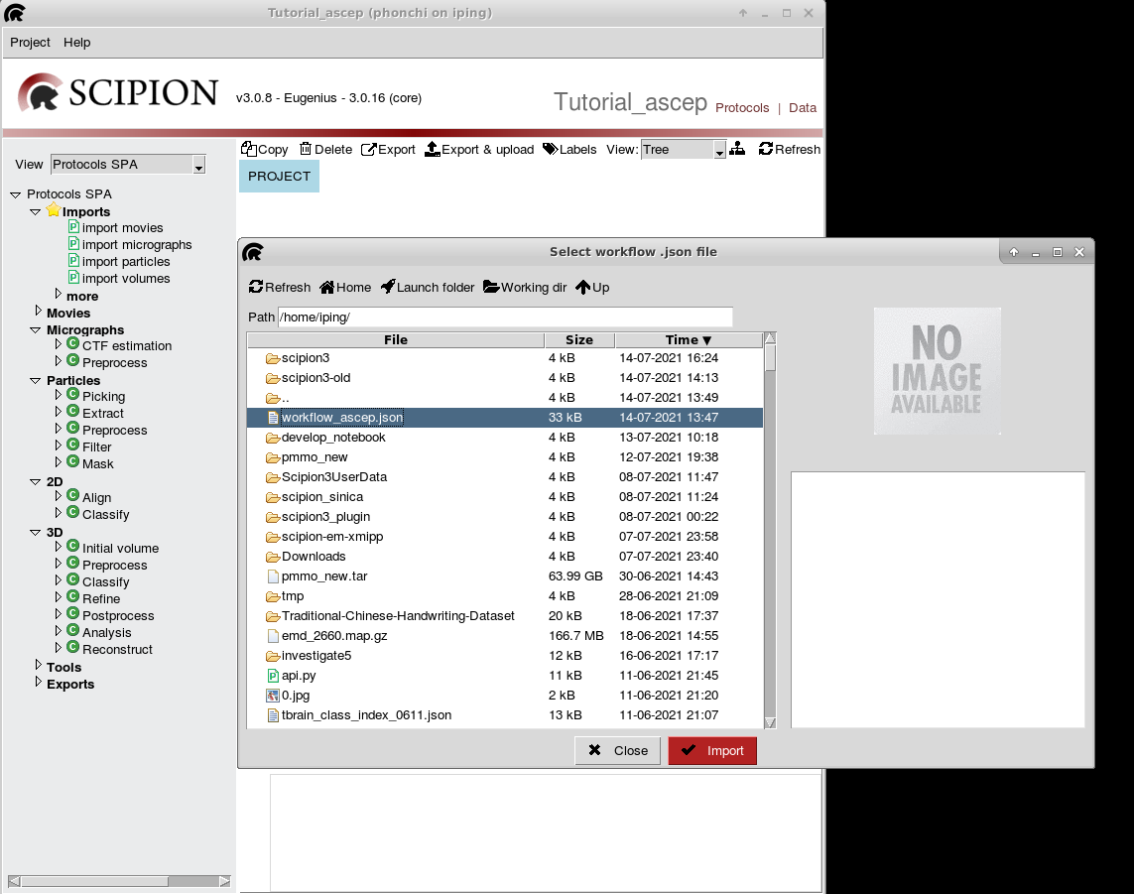
Import/Export workflow
按下Create，就會出現操作介面->import workflow /home/iping/workflow_ascep.json

Slide 23
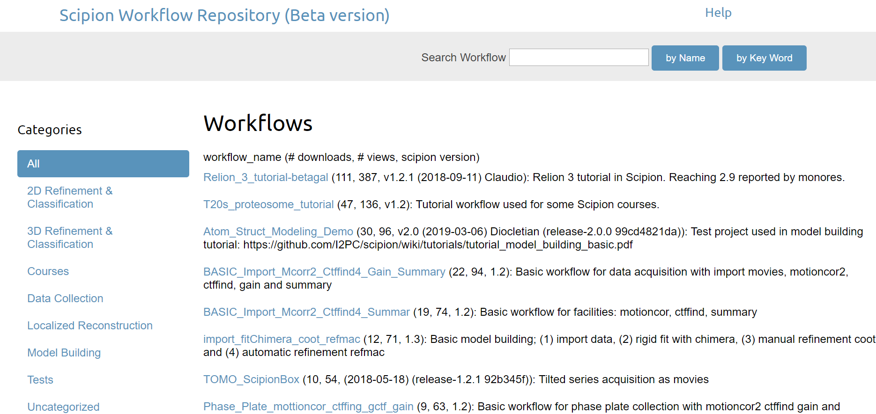
Upload workflow
http://workflows.scipion.i2pc.es/

Slide 24
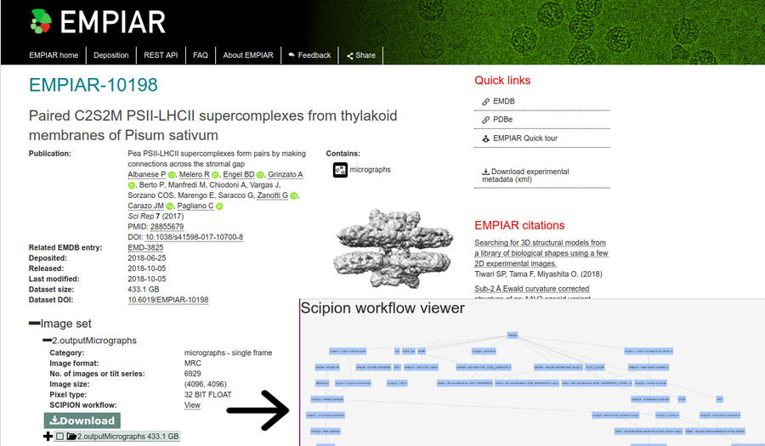
Upload workflow

Slide 25
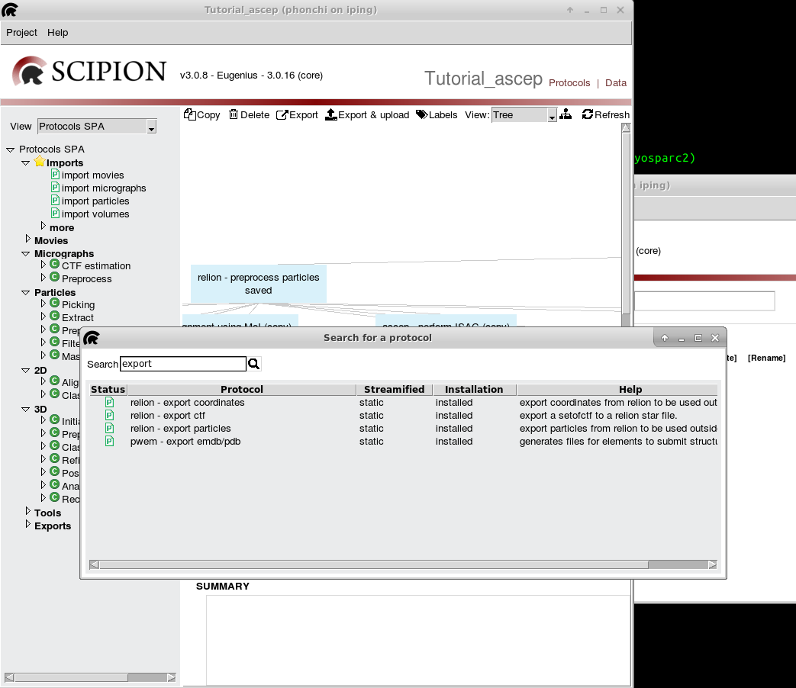
Import/Export metadata/binaries
Use ctrl+a to select all blocks and right click to export workflow
Use crtl+f to search protocol

Slide 26
Basic Usage

Slide 27
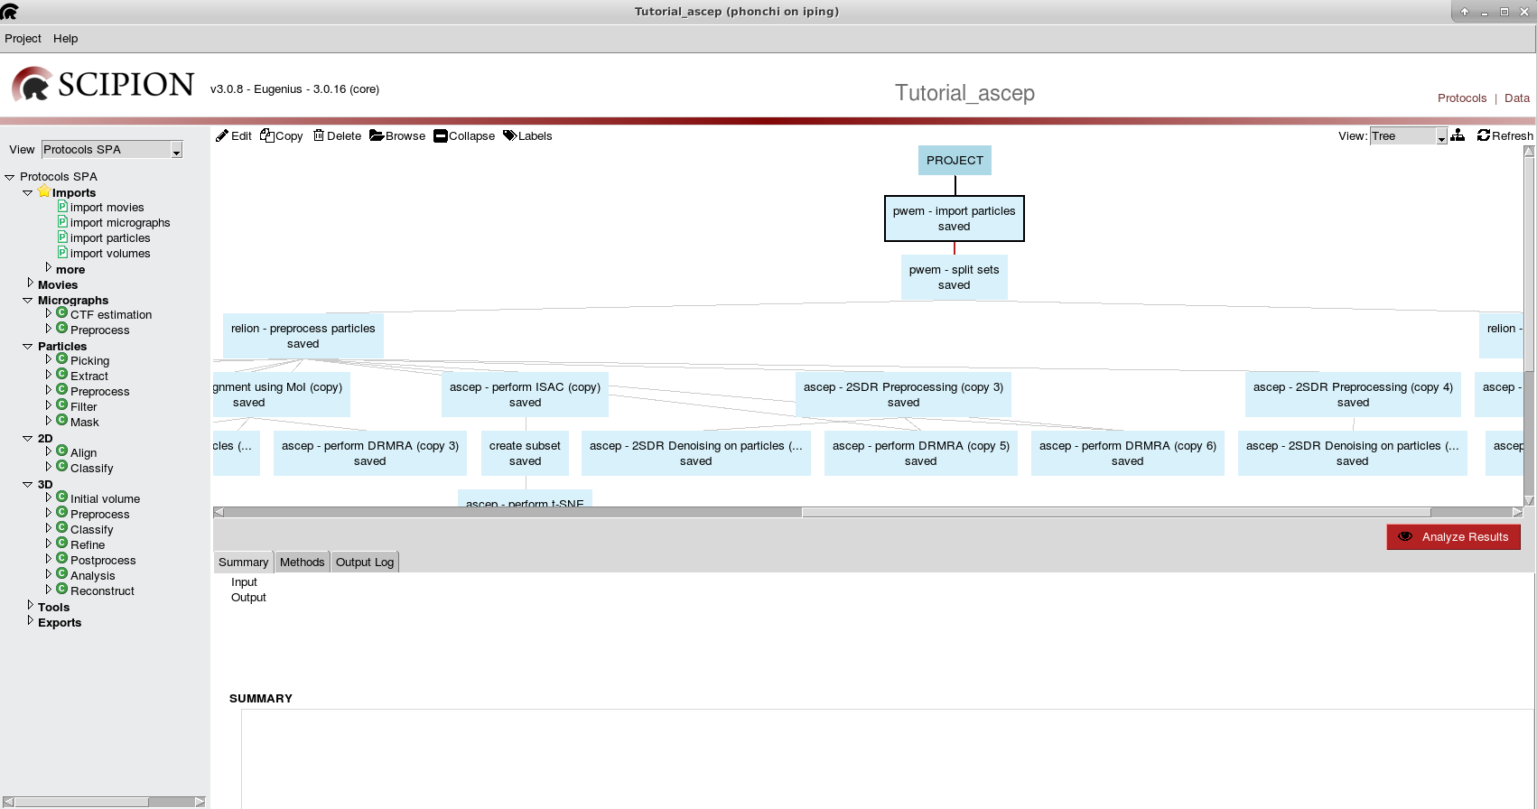
執行區
指令區
查看結果
說明區

Slide 28
可切換模式
如果進到操作介面是凌亂的情況，或者需要對流程做整理，點選此圖，程式會自行整理順序。

Slide 29
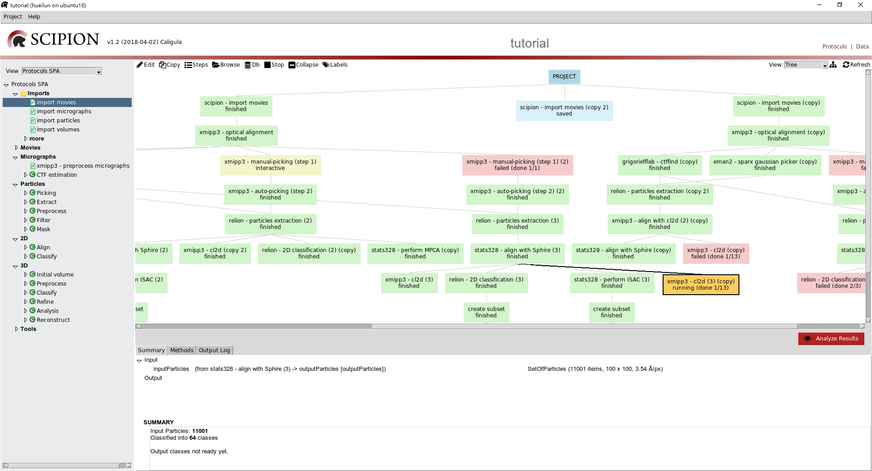
框框的顏色分為四種
1.藍色:代表只儲存操作指令，並未執行。
2.綠色:指令執行完。
3.黃色:指令執行中。
4.淡黃色:指令執行結束，還可以點進去繼續執行，
但底下有接其他指令不可再執行會出現錯誤。
5.紅色:出現錯誤。

Slide 30
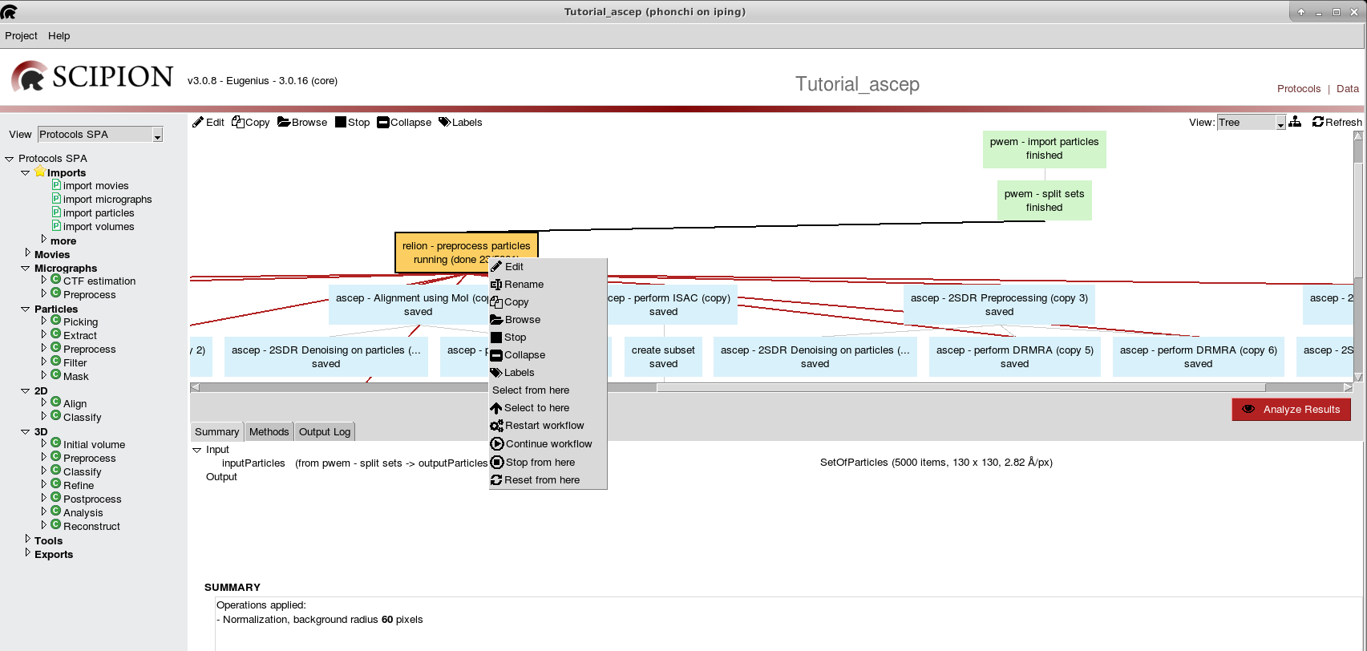
點選框框，按下滑鼠右鍵，會出現一排的選項，
:會出現指令操作
:複製此次的指令操作
:刪除此次操作，但有連接下一步，則無法刪除
:此次操作所存的檔案位置
:停止此操作，只有在運行中的指令才會出現
其他比較少使用就不介紹，但是可以去玩玩看。

Slide 31
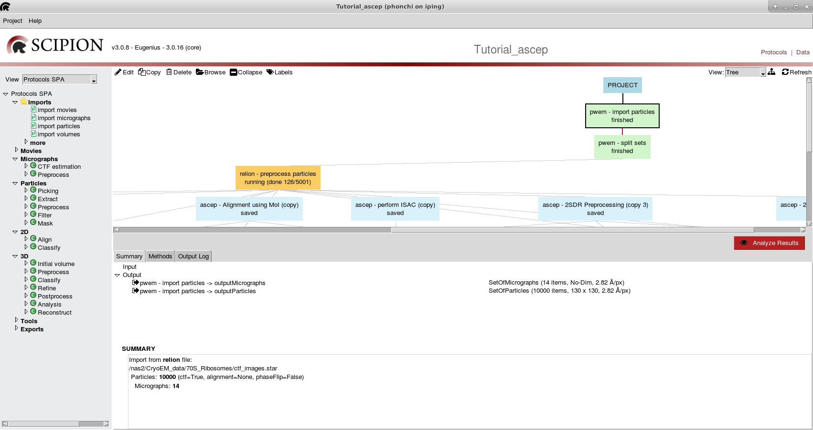
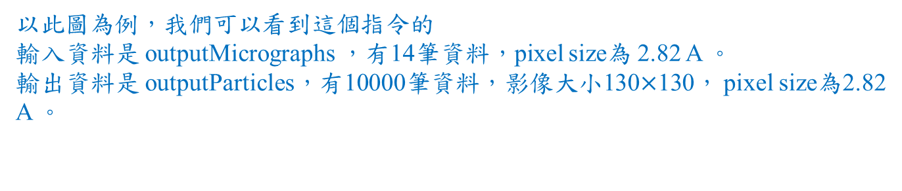
點選其中一個框框，在說明區會出現該指令的說明
1.Summary:
該指令輸入及輸入的資料訊息。
2.Method :方法說明及references。
3.Output Log: 程式執行過程。
以此圖為例，我們可以看到這個指令的
輸入資料是 outputMicrographs ，有14筆資料，pixel size為 2.82 A 。
輸出資料是 outputParticles，有10000筆資料，影像大小130$×$130， pixel size為2.82 A 。

Slide 32
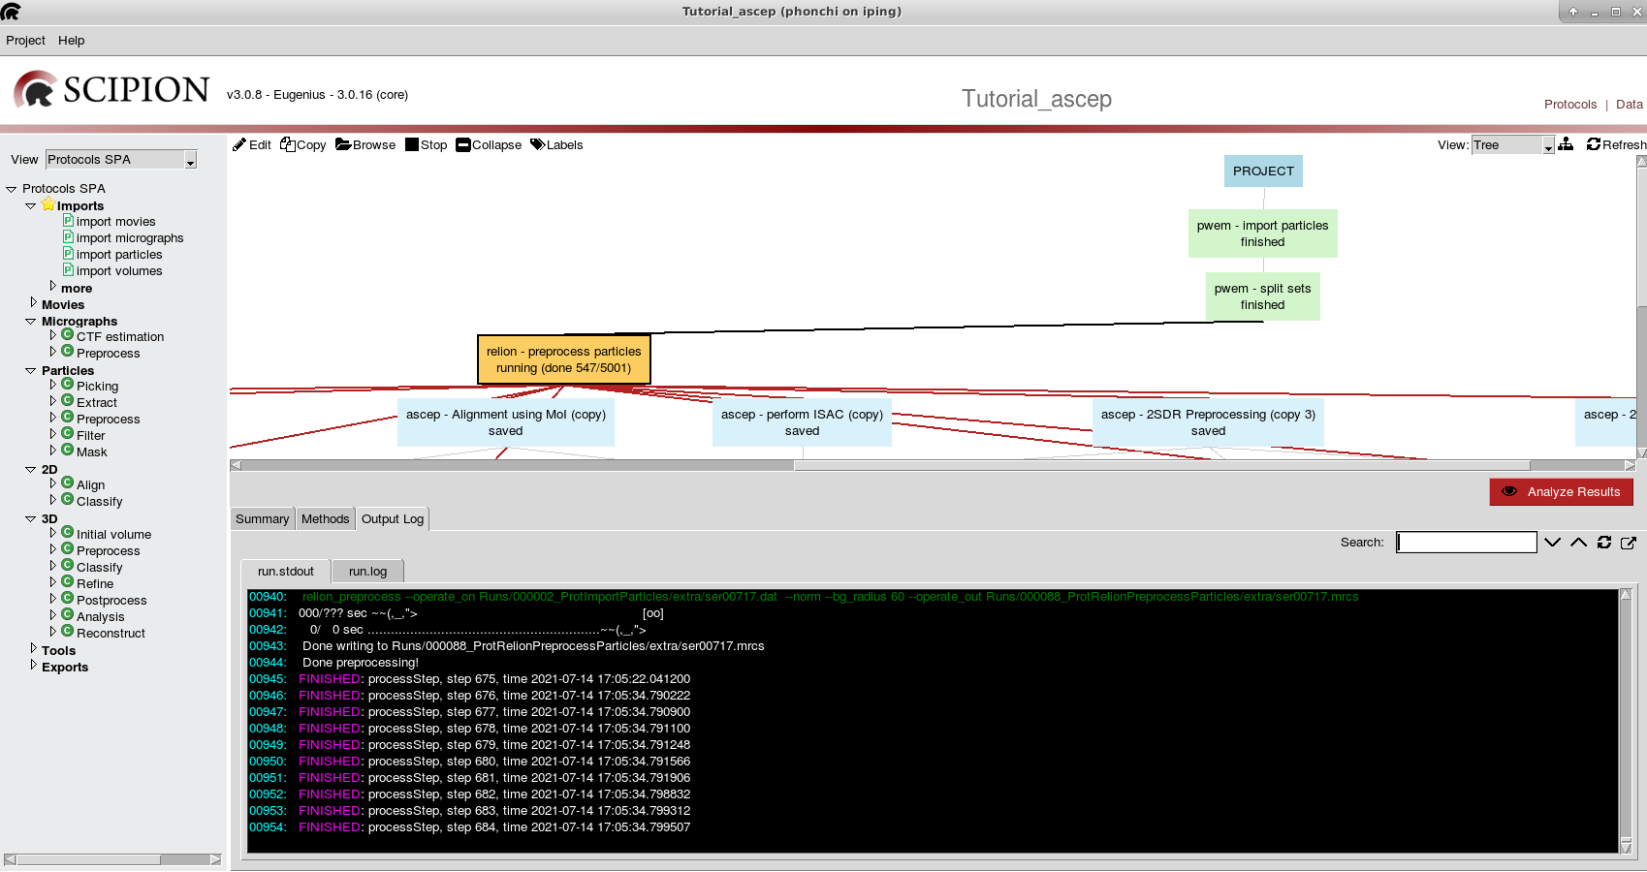
錯誤情況判斷查閱說明區 Output Log →run stdout
若沒有出現紅字，有可能是執行到一半斷掉，重新執行即可。
若出現紅字，先改放入參數，再重新執行，或者選擇其他指令執行!!!

Slide 33
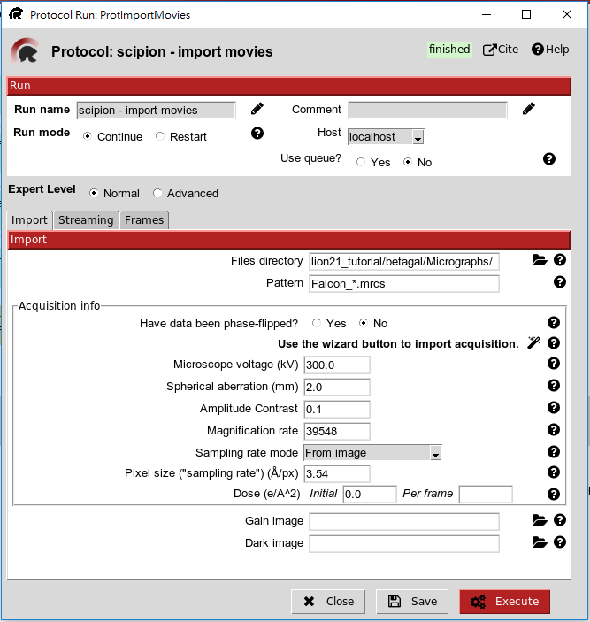
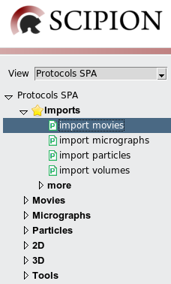
Imports
2
填寫
1.資料檔案位置
1
2.資料名稱
*.mrc 代表讀取所有的 .mrc檔
依照資料選擇輸入方式
點選
3
3.按下Execute ，
執行此過程。
Save 只會儲存輸入的訊息，並不會執行，
Execute 會儲存及執行此步驟。

Slide 34
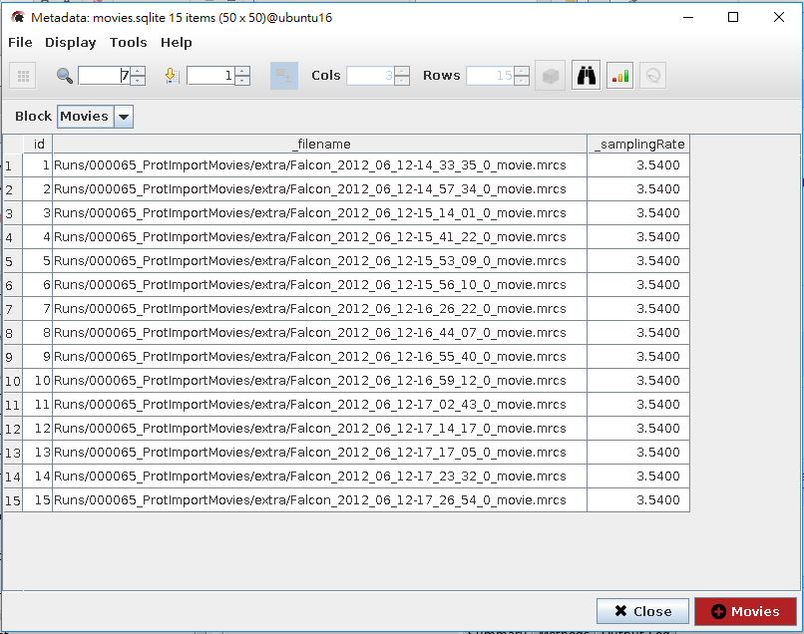
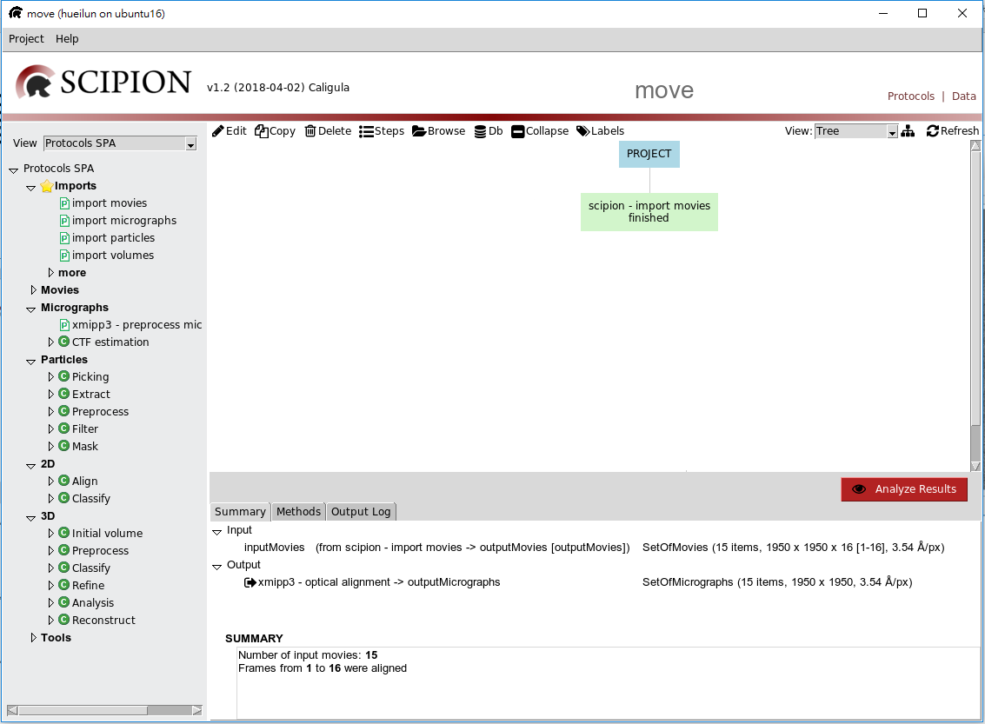
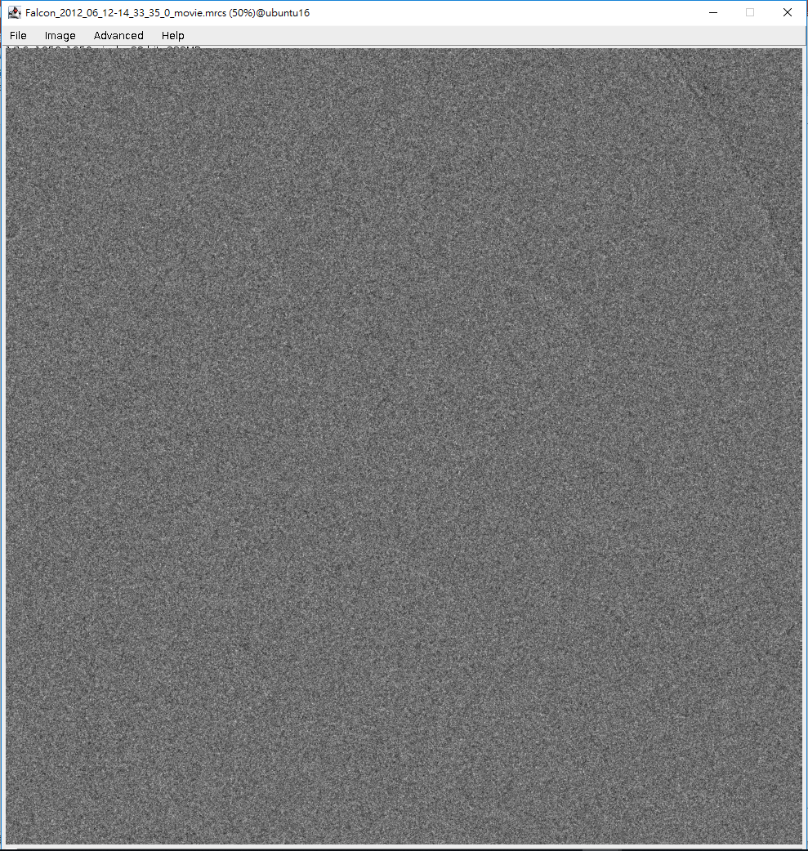
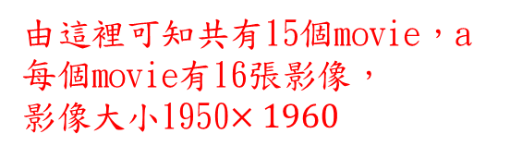
查看執行結果
3
點兩下會出現單張影像的圖像。
1
點選這個綠色框框
2
點Aanlyze Results
由這裡可知共有15個movie，a每個movie有16張影像，
影像大小1950$×1960$

Slide 35
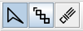
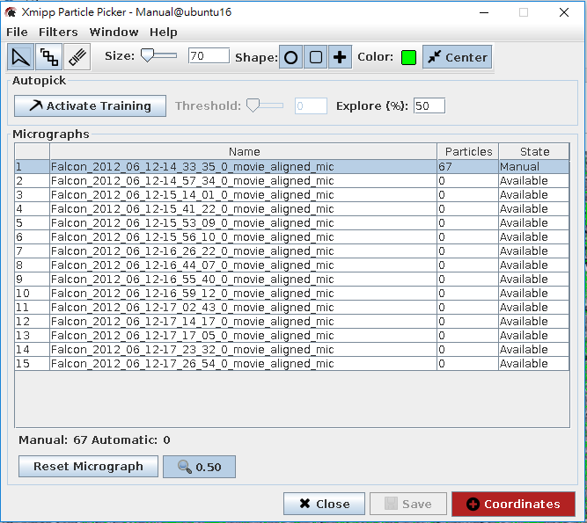
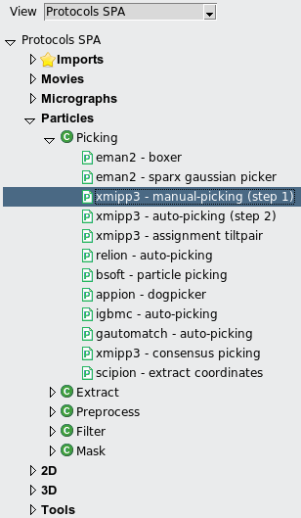
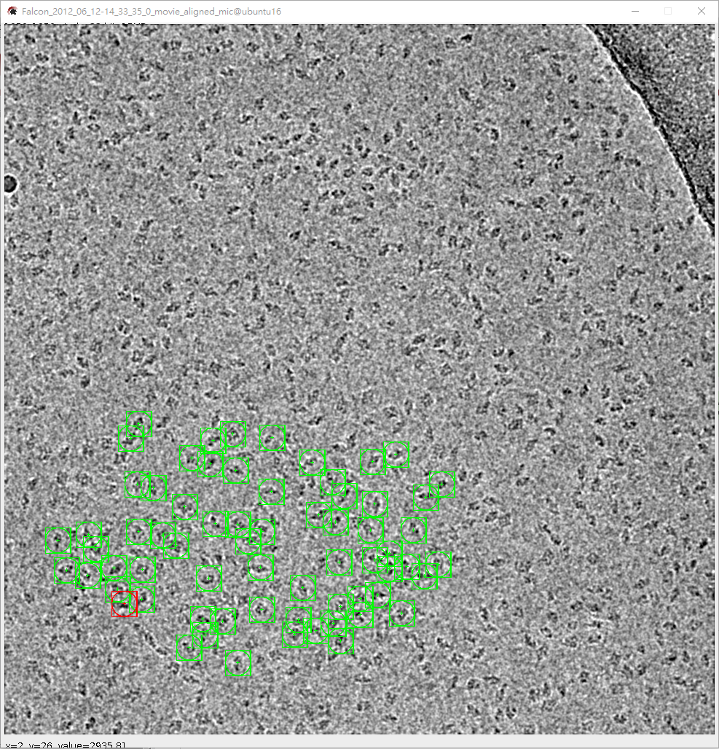
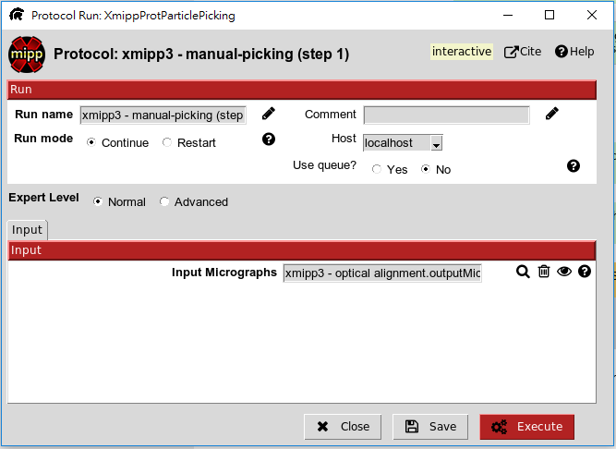
Particle picking
圈選工具
4
調整框框size，可以先圈一個particle，再來回調整
圈particle 的標示
連續圈選，不好用
6
橡皮擦，用來刪除框框
圈了一些particle 在按這個按鈕
1
5
圈 particle
2
按 找到要輸入的資料
下一頁
3

Slide 36
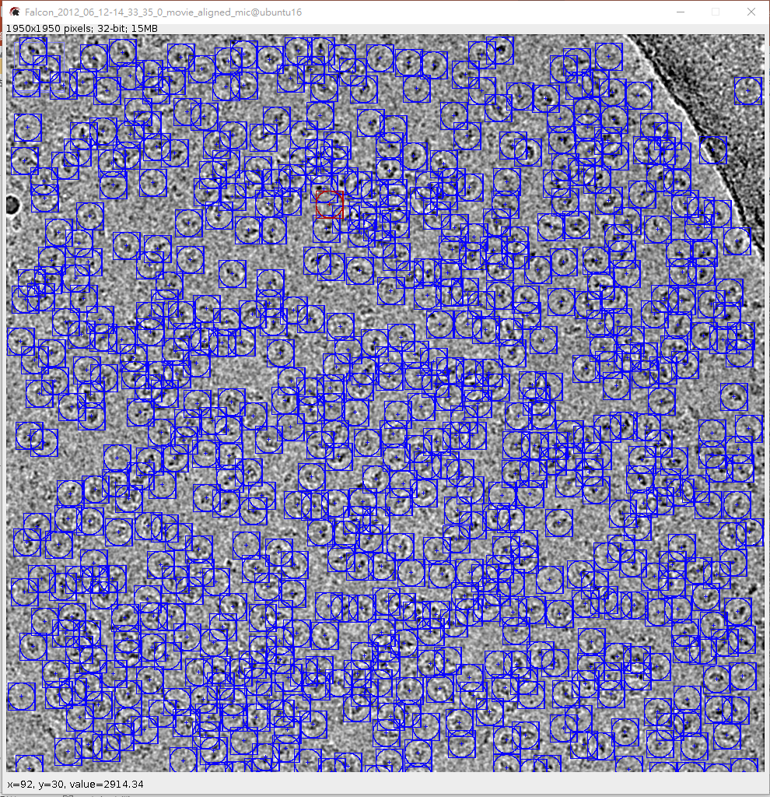
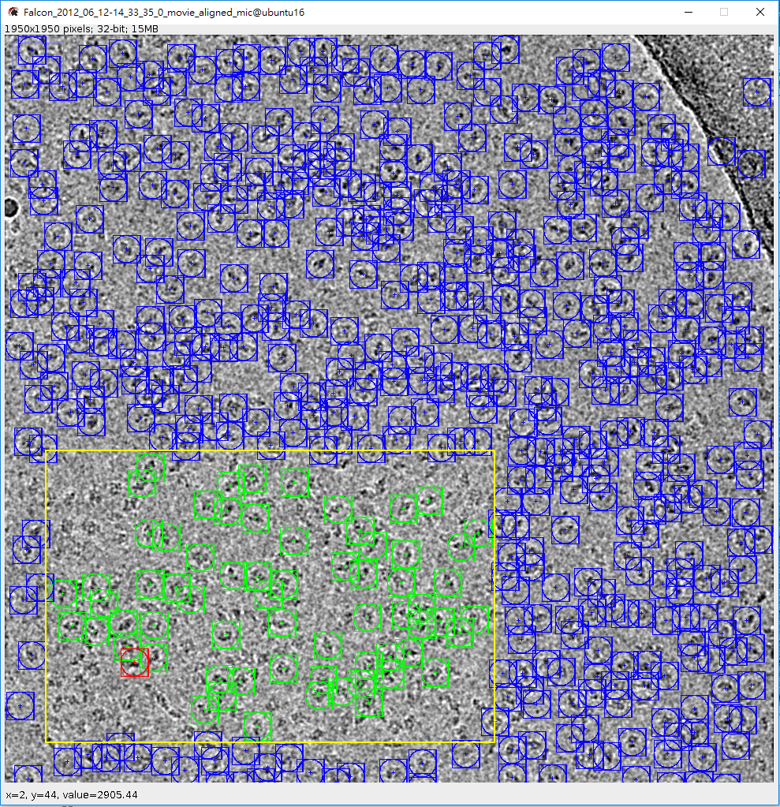

第6步這個動作會讓程式自己圈選，但是可以看到黃色框框區域還有些沒選到
8
調整Threshod會影響最後particle選入的數量
9
在此只需做完一張 mircographs的 particle picking，其他張使用
Auto-picking
7
按下 Reset Micrographs 使之全部重選

Slide 37
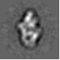
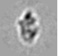
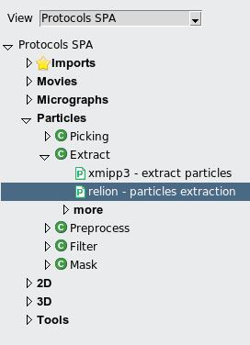
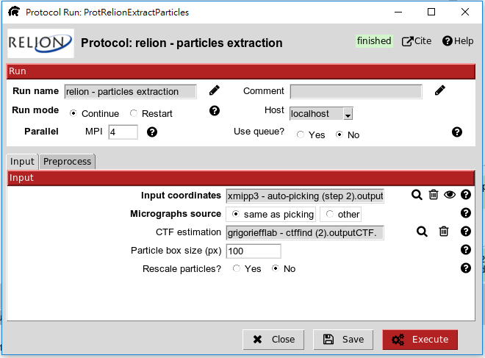

Extract
1. Invert contrast 改變 particle 的顏色，
慣用 白色 particle。
白色
黑色
2. Recommend
Xmipp extraction- for xmipp, eman2, sparx
Reion extraction- for cryosparc2 and relion (Especially in 3D part)
1
2
3
Invert contrast : Yes !!
按 找到要輸入的資料，
Particle box size 自行調整
3. Bin the particle to speed up processing before 3D Refinement
4

Slide 38


https://scipion-em.github.io/docs/docs/user/scipion-gui.html
ShowJ (Connect with ImageJ and Chimera)
1
隨意一張圖按下滑鼠右鍵會出現選項
Enable: 選入這個class
Disable:不要這個class
像這種只要丟棄第一個class，可以先對第一個class 點選disable，在點
Select→ALL。
2

Slide 39



ShowJ
可以看到particle 的分層，如果想看3D圖，
點選chimera
點選這個綠色框框
1
2
點Aanlyze Results

Slide 40


Other viewer/statistics
當你點下Aanlyze Results，並沒有出現分組結果，而是出現下列這些框框，此時請點 ，
就會出現執行結果。
cl2d
relion

Slide 41


MPI/GPU
使用CPU個數，可自行調整，
1
2
按 找到要輸入的資料
3

Slide 42

MPI/GPU
浮標指向其中一個框框，停留一段時間，會出現該指令執行時間。

Slide 43
Break
Manual
https://github.com/I2PC/scipion/wiki/tutorials/scipion_tutorial_betagal.pdf
Or 卉倫的ppt

Slide 44
ASCEP

Slide 45



ASCEP: More Competitive Algorithms to Meet Current Challenges
DRMRA
DRMRA
ISAC
CryoSparc
Robust PCA
2SDR
i-tSNE
CNN
Network
$$PrePro$$
$$rAMI$$
PRIME
Still growing…
Model Bias

Slide 46






ASCEP : Enable us to select a best workflow – pMMO molecule
(Wei-Hau Chang , Hsin-Hung Lin , I-Kuen Tsai, Shih-Hsin Huang , Szu-Chi Chung , I-Ping Tu , Steve Yu, Sunney I. Chan, “Copper Centers in the Cryo-EM Structure of Particulate Methane Monooxygenase Reveal the Catalytic Machinery of Methane Oxidation”, Accepted by Journal of the American Chemical Society. , (2021).)
Notes:
electrostatic potential

Slide 47






ASCEP – CryoRALib
Multiple initial 2D models will be generated through clustering of the raw dataset
This procedure works well under low SNR settings
Particle images
Max ${CC}_{j}$
$${CC}_{1}$$
$${CC}_{2}$$
$${CC}_{3}$$
$${CC}_{4}$$
$${CC}_{5}$$
…
50~500
Orientation parameters
Calculate CC in
different $(φ,x,y)$
2D models
PCA+Kmeans
(Szu-Chi Chung, Cheng-Yu Hung, Huei-Lun Siao, Hung-Yi Wu, Wei-Hau Chang, I-Ping Tu, “Cryo-RALib –
a modular library for accelerating alignment in cryo-EM ”, Accepted by IEEE International Conference on Image Processing (ICIP) , (2021).)
Notes:
The goal is to obtain the 3D structure, that is the roughly 10^6 voxel values in a 3D density map, from perhaps 10^9 very noisy pixels in a dataset
of particle images. To solve the structure, ideally one would examine all possible density maps and pick the single one
that best matches the dataset, given a scoring function such as the squared error or the likelihood.
one comfort is that the gross misassignment of angles generally results in low-resolution reconstructions. Thus, it is to be hoped that an interpretable,
high-resolution map is unlikely to suffer from model bias.
When the data quality is high, convergence to the global optimum is quite reliable and initial models such as smooth ellipsoids or random densities result in correct structures.
However, when the SNR of the images is low or when preferential particle orientation causes the strong overrepresentation of certain projection directions, model bias can be severe
Reliable 3D model using stochastic approach or experiment (tilt-pair analysis, random conical tilt)
Find the set of parameters that most likely determine the observed data
Discrete parameter assignment are replaced by probability-weighted integrations over all possible assignments
Each image is assigned by all orientations and classes with weights
0≤φ≤360, 0≤θ≤180, 0≤ψ≤360

Slide 48


























2SDR method
Solving eigenvectors of covariance matrix with size $t×t$ is $O(t^{2}r)$
$$HOSVD$$
$$MPCA$$
$\frac{1}{n}\sum_{i=1}^{n}{(X_{i}−\overline{X})}{(X_{i}−\overline{X})}^{T}$
(size: $p×p$)
$\frac{1}{n}\sum_{i=1}^{n}{(X_{i}−\overline{X})}\hat{B}{\hat{B}}^{T}{(X_{i}−\overline{X})}^{T}$
(size: $p×p$)
$$\frac{1}{n}\sum_{i=1}^{n}{{\hat{V}}_{i}{{\hat{V}}_{i}}^{T}}$$
$${\hat{V}}_{i}=vec\left({\hat{U}}_{i}\right)$$
(size: $p_{0}q_{0}×p_{0}q_{0}$)
Assuming
$p=q=100$
$$p_{0}=q_{0}=10$$
$$r =10$$
$\frac{1}{n}\sum_{i=1}^{n}{{(X_{i}−\overline{X})}^{T}}\hat{A}{\hat{A}}^{T}(X_{i}−\overline{X})$
(size: $q×q$)
$\frac{1}{n}\sum_{i=1}^{n}{{(X_{i}−\overline{X})}^{T}}(X_{i}−\overline{X})$
(size: $q×q$)
$$q$$
$$2SDR$$
$$p$$
$$q_{0}$$
$$p_{0}$$
$${3×10}^{5}$$
$$\hat{A}$$
$$\hat{B}$$
$$\hat{G}$$
$$\hat{Г}$$
$$q$$
PCA
$$p$$
$$\frac{1}{n}\sum_{i=1}^{n}{(y_{i}−\overline{y}){(y_{i}−\overline{y})}^{T}}$$
(size: $pq×pq$)
$${10}^{9}$$
(“Two-stage dimension reduction for noisy high-dimensional images and application to Cryogenic Electron Microscopy”, Annals of Mathematical Sciences and Applications, 2020)

Slide 49



ASCEP – 2SDR
SetOfParticles
deselect to use PCA
deselect to use MPCA

Slide 50




Can be used with downstream analysis

Slide 51





2SDR denoising helps on alignment – PrePro
Transform
Orientation
parameters
CCC
2SDR
CCC
Orientation
parameters
Reference-Based
Alignment

Slide 52



















2SDR denoising helps on alignment – PrePro [6]
Using 70S ribosome
21 most correlated images are averaged using original data
Transform
Reference
Orientation
Without 2SDR
parameters
CCC
2SDR
Orientation
CCC
parameters
With 2SDR
Reference-Based
Alignment
Ground Truth
(“Pre-Pro is a Fast Pre-Processor for Single-Particle Cryo-EM by Enhancing 2D Classification”, Communications Biology, 2020)
Notes:
It will be helpful in alignment

Slide 53





ASCEP – PrePro
Seldom used
Expected radius in pixel
Specify MPI and GPU

Slide 54





Average
Already aligned!
For DRMRA

Slide 55








rAMI –Rapid Alignment with Moment of Inertia for Cryo-EM Image Processing
Compute $I$ and solve eigenvectors
Denoise by 2SDR
Noisy image
Align major axis with $x$-axis
Denoised image
MoI
MoI_rf
rAMI
Fine-tune by checking the flip and rotation
RFA
(Szu-Chi Chung, Shao-Hsuan Wang, Cheng-Yu Hung, Wei-Hau Chang, I-Ping Tu, “rAMI –Rapid Alignment with Moment of Inertia for Cryo-EM Image Processing”, Accepted by Microscopy and Microanalysis 2021 Meeting , (2021).)

Slide 56



rAMI –Rapid Alignment with Moment of Inertia for Cryo-EM Image Processing
Betagal
70S ribosome

Slide 57



ASCEP – RAMI
Feed into RFA

Slide 58




Slide 59


$γ$-SUP (Self-Updating Process)
Different influence region (attraction force)
Do not need to specify the number of cluster or the random initialization of centers
Robust to outlier (contaminates)
(Chen, Ting-Li and Hsieh, Dai-Ni and Hung, Hung and Tu, I-Ping and Wu, Pei-Shien and Wu, Yi-Ming and Chang, Wei-Hau and Huang, Su-Yun. $"γ$-SUP: A clustering algorithm for cryo-electron microscopy images of asymmetric particles.” The Annals of Applied Statistics, 8(1), 259-285. (2014))
Notes:
27 points

Slide 60



ASCEP – R-SUP
From dimensional reduction method
Can use r-estimator
Larger value means we collect larger neighborhood into the same cluster
The size of outlier class

Slide 61




Select according to maximum of $\#cluster×\#particles$
Other value of tau, dyna,ically computed
Outlier will be put into max class number

Slide 62


ASCEP - Clustering
Different algorithm will have different parameters

Slide 63

DRMRA

Slide 64




DRMRA (a-$γ$-SUP )
Data matrix $X∈R^{n×p}$, $n$ samples with $p$ features, tuning parameter ($s, τ$)
Iter $←0$
Start with ${\tilde{μ}}_{i}←\frac{x_{i}}{τ}, i=1,…,n$
Repeat
tree = construct_Tree_or_hash({${\tilde{μ}}_{i}$})
For $i=1:n$
NN = tree.nearestNeighbor(${\tilde{μ}}_{i}$)
$$w_{ij}←\exp_{1−s}\left(−{\left\|{\tilde{μ}}_{i}−{\tilde{μ}}_{j}\right\|}_{2}^{2}\right), j∈NN$$
$$z_{i}←\sum_{j∈NN}{\frac{w_{ij}}{\sum_{k∈NN}{w_{ik}}}}{\tilde{μ}}_{j}$$
End
$${\tilde{μ}}_{i}←z_{i}, i=1,…,n$$
Iter = Iter+1
Until convergence
Output cluster centers $\{τ{\tilde{μ}}_{i}, 1≤i≤n\}$ and cluster membership
Space-partition tree is used
Reduce pairwise-distance calculation $O(N^{2})$ to $O\left(N\log{N}\right)$ or $O(N)$
Dynamic SUP is employed
Increase $k$ in each iteration
Focus on local structure at the beginning
Finding working parameter $τ$
A coarse-grained binary search to find the range of nontrivial solution
Grid search on the range

Slide 65




Only use a few classes for alignment
Partition the dataset, usually 5000~20000
Correct CTF, put full size image here
Use t-SNE to generate initial class averages
From PrePro
Adjust C in the final
round

Slide 66



Cleanup for downstream analysis

Slide 67

ASCEP – GPU ISAC/CryoRALib
EQ-Kmeans

Slide 68




t-SNE (Manifold Learning)
Input $x_{1},…x_{N}$ in $pq$ dimension
Output $y_{1},…y_{N}$ in 2 or 3 dimension
PCA/2SDR embedding
t-SNE
(Maaten, Laurens van der, and Geoffrey Hinton. "Visualizing data using t-SNE." Journal of machine learning research 9.Nov (2008): 2579-2605.)
Notes:
http://www.datakit.cn/blog/2017/02/05/t_sne_full.html

Slide 69



ASCEP – ITSNE, TSNE, TRANSFORM
Select yes for particles for DRMRA or ISAC
For other classification tasks

Slide 70


1) Use Lasso tool or Box select
2) Save the selection class
3) Press close if you are done

Slide 71
Other methods
2D conformation analysis based on network
CNN for auto selection of classes
3D methods
Other Issue
CTF and phase plate

Slide 72
Advance

Slide 73



尋找輸出資料路徑
3
大多數的資料都存在extra 裡面
點選需要的輸出資料的框框，按下滑鼠右鍵，會出現一排的選項，點取 Brower
1
2
→有了路徑就能從外部的資料夾找到檔案，
也可以透過 ftp直接到從資料夾載資料。

Slide 74

下載需要的參數資訊
3
假設今天我想下載 movement alignment 的位移資訊
點選有 這個符號的檔案
點選需要的輸出資料的框框，按下滑鼠右鍵，會出現一排的選項，點取 Brower
1
4
2
點選Browse Data
下一頁

Slide 75



6
將Table的地方調成Objects
9
調整檔案位置及名稱，名稱記得打上 .txt
10
5
8
找到我們要的資料位置，
在此為c13、c14
7
複製c13、c14行的資料到這裡

Slide 76
Recommend method
Stage | CPU | GPU
Motion Correction | Unblur | MotionCor2
CTF Estimation | Ctffind4 | Gctf
Particle Picking | Xmipp Relion | CrYolo Topaz
Alignment | RAMI PrePro | PrePro
2D Classification | ISAC CL2D DRMRA | GPU ISAC Relion CryoSparc DRMRA
2D Validation | i-tSNE t-SNE 2SDR

Slide 77
3D Initial Model | Simple Eman2 | CryoSparc
3D Classification/ Validation | Xmipp Validation tool | Relion 3D Classification/Multibody Refinement CryoSparc Nonuniform/Local Refinement
3D conformation analysis |  | 3DVA CryoDrgn
3D Refinement | Xmipp High Res | Relion CryoSparc
Polishing |  | Relion CTF Refinement Relion Bayesian Polishing

